Slide 1
The Kings Meadow Dragons –
Characteristics of Effective Learning
The dragons all have different characteristics for effective learning!
When they all work together as a team, a project can be completed or a problem can be solved. They support the children in their thinking and ensure they develop positive attitudes to learning.
From being resilient to being creative, the children learn to think like a different character throughout a project and develop their own skills in problem solving!

Slide 2

Meet Dragon Explorer!
Characteristics: (Links to Planning & Exploring – Engaging)
• It loves finding out and exploring
• It is curious.
• Uses its senses to explore the world.
• Engages in open-ended activity
• It shows particular interests in projects

Slide 3
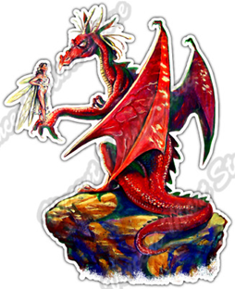
Meet the Resilient Dragon
Characteristics: (Being willing to ‘have to go’) (Active Learning Motivation - Keep on trying)
• It is always willing to ‘have a go’
• It initiates activities
• It loves a challenge
• It always has a can do attitude
• It takes a risk, engages in new experiences, and learns by trial and error
• It keeps on trying
• It persists with activity when challenges occur
• It shows a belief that more effort or a different approach will pay off
• It always bounces back after difficulties

Slide 4

Meet The Dragon in Charge
Characteristics ((Active Learning -Motivation - Being involved and concentrating) (Creating and Thinking critically – thinking)
• The DRAGON IN CHARGE has his own ideas
• It thinks of ideas
• It finds ways to solve problems
• It finds new ways to do things
• It has high levels of energy, fascination
• It is not easily distracted and concentrates

Slide 5
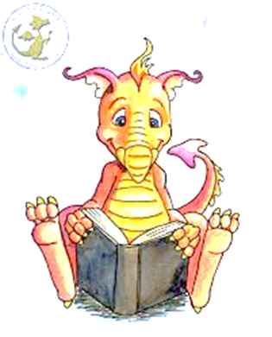
Meet Mr. Problem Buster:
Characteristics (Creating & Thinking Critically - Making links)
• It makes links and notices patterns in his experience
• It makes predictions
• It tests his ideas
• It develops ideas of grouping, sequences, cause and effect

Slide 6
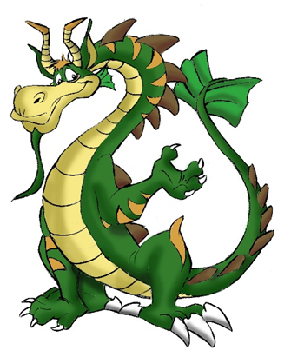
Meet the wise dragon
(Creating & Thinking Critically - Choosing ways to do things)
• It is the ultimate problem solver.
• It chooses ways to do things
• It plans and makes decisions about how to approach a task,
• It solves a problem and reaches a goal
• It checks how well their activities are going
• It changes strategy as needed
• It reflects upon their approach

Slide 7
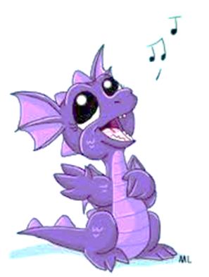
Mr. Performer
• Is it confident
• It is expressive
• It can improvise
• It can sing, dance, perform
• It loves drama and changes roles into different characters
• It can project and use intonation in its voice
• It connects with the audience

